Slide 1
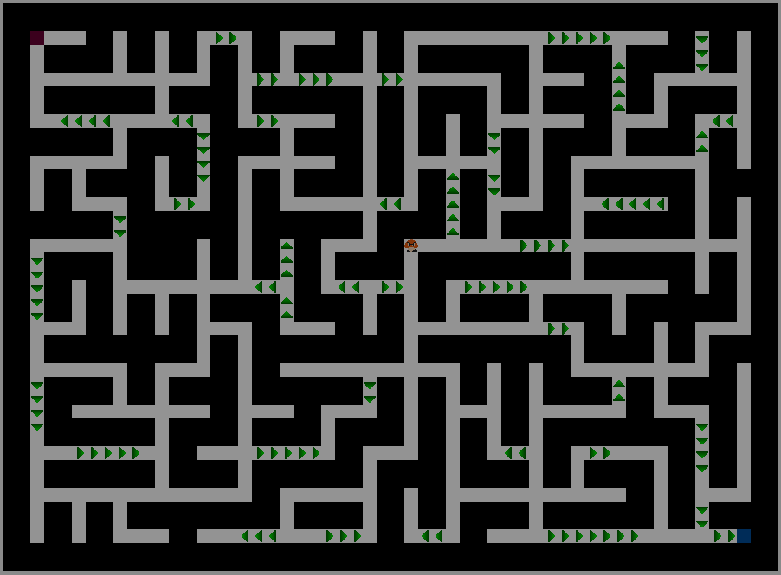
Maze
Group F
Tina Taleb
Curtis Spears
Yushi Sato

Slide 2
Overview
UML + Sequence Diagram
2 Dimensional Maze
Directed Graph
Maze is randomly created

Slide 3
UML

Slide 4
Sequence Diagram

Slide 5
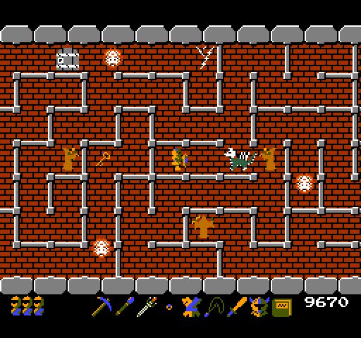
Random Maze Generating Algorithm
Inspired by the algorithm used in
“The Tower of Druaga”
by Namco in 1984

Slide 6
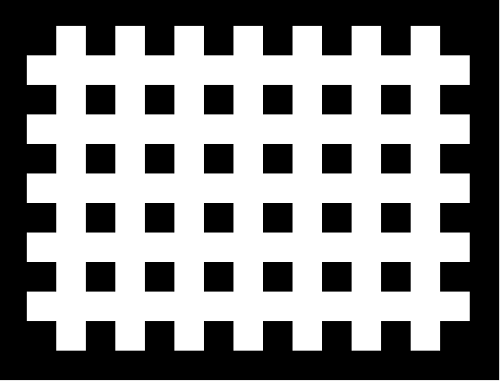
1st step - Path generation
Put ‘poles’ in the brank maze

Slide 7
2nd step
For each pole, randomly duplicate pole at adjacent block.
25%
25%
25%
25%

Slide 8
Repetition
25%
25%
25%
25%
New

Slide 9
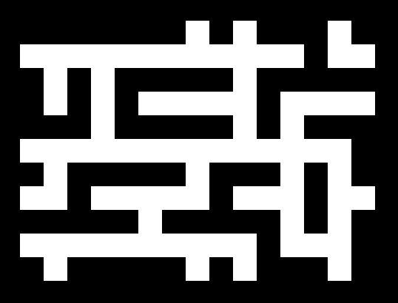
Blueprint

Slide 10
2nd Step - Oneway generation
Pick ‘start’ and ‘goal’
G
S

Slide 11
Dijkstra's algorithm - find shortest path
On the shortest path,
randomly choose path to be a directed way that directs start to goal
G
S

Slide 12
2nd Step - Oneway generation
Randomly generate one ways on other path except on the shortest path we found.
G
S

Slide 13
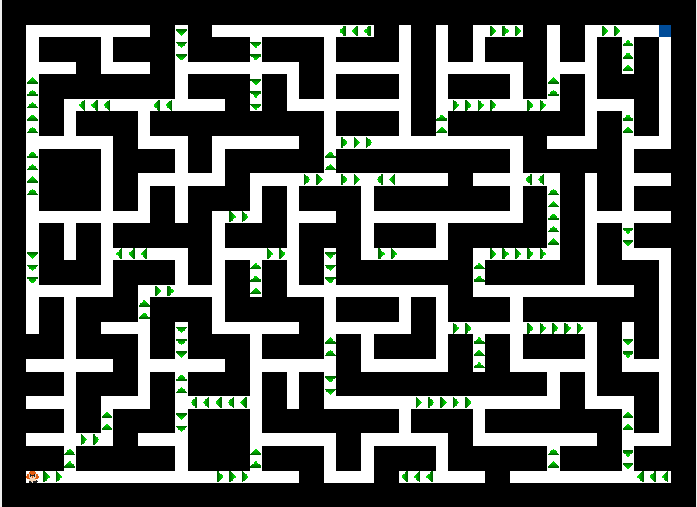
What we have

Slide 14
Future Developments
Adding lighting feature
Adding a hint button
Adding time limit
Adding 2 player option (wasd & arrows)
Adding enemy

